Slide 1
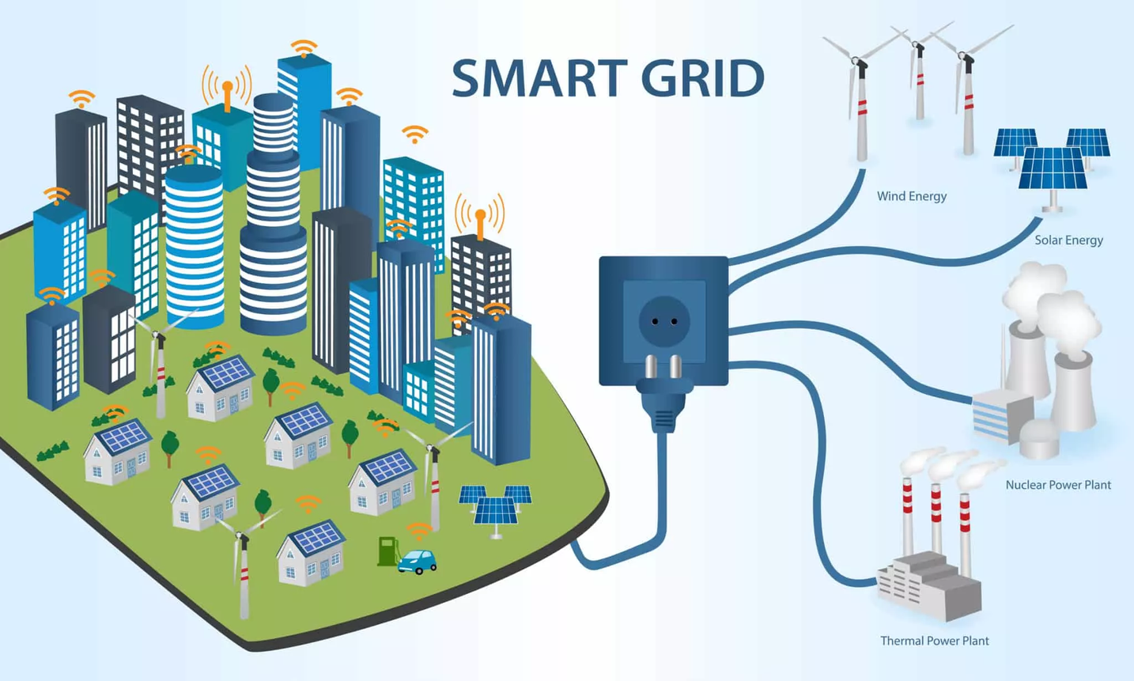



Smart Trading System
Our Team
Luca Barotto s329657
Marco Cutarelli s331196
Matteo Sabbatini s331202
Simone Terranova s331343
Riccardo Fida s327834

Slide 2
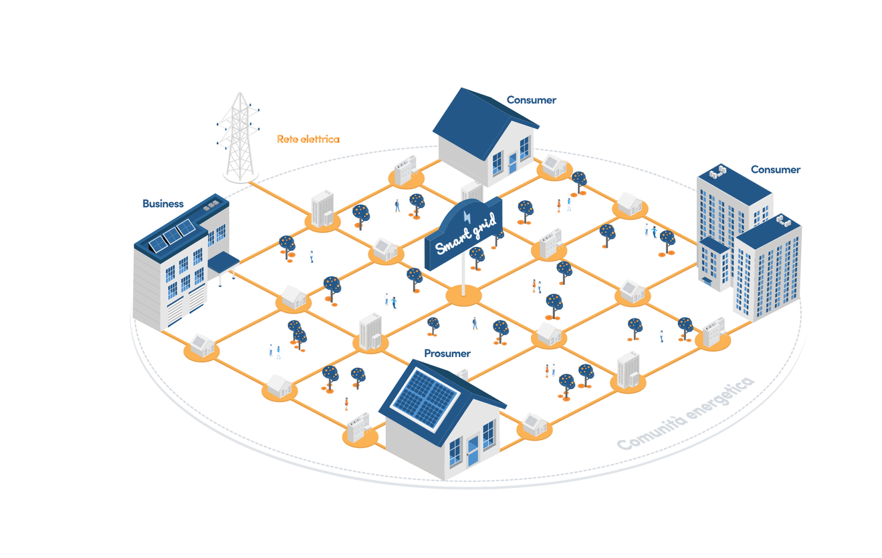
Overview
Project Definition
Trading Partner
Consume Definition
Trading Strategy
Conclusion

Slide 3


Project Definition
The “Smart Trading Systems” project is an intelligent energy trading system designed to optimize energy distribution and consumption between various prosumers (producer-consumers) and consumers. It uses optimization algorithms to balance energy production and consumption, reducing costs and improving energy efficiency.

Slide 4

Trading Partner
It represents partner with capacity, reliability and a pricing curve in the time.
Prosumer: An actor who both produces and consumes energy, selling any surplus energy on the market.
Consumer: An actor who exclusively consumes energy, with a defined energy load.

Slide 5
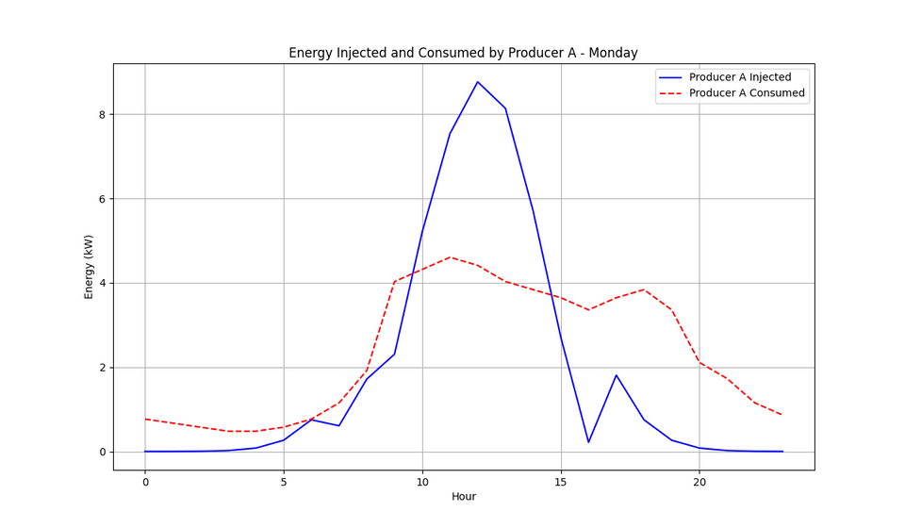
Prosumer
In the context of the "Smart Trading Systems" project, prosumers play a crucial role in balancing energy supply and demand. They generate energy (e.g., through solar panels or wind turbines) and consume it for their own needs, while any surplus energy can be sold on the market. Prosumers are equipped with specific attributes, such as energy production capacity, consumption patterns, and economic preferences, which influence their behavior and decision-making in the energy market.
Name
Reliability
The name of the prosumer
The reliability attribute is used to calculate the trading partner score. A higher reliability value indicates greater reliability in energy production ( value range used is [0.85,0.95] ).
Capacity
Score
The maximum amount of energy generated by the prosumer. This value represents the prosumer's production capacity (kW).
A lower score indicates a prosumer with better performance.
It is given by:
price / (capacity * reliability)
Market Cost
Consume
The market cost of energy for the prosumer. This value represents the price the prosumer pays for energy purchased from the market.
The amount of energy consumed by the prosumer. This value represents the prosumer's energy demand

Slide 6
Consumer
Name
The name of the consumer
A consumer is an entity that solely consumes energy. In the context of the "Smart Trading Systems" project, consumers represent the energy demand within the system. Each consumer has a specific energy load, which corresponds to the amount of energy they require for their operations or daily activities. Consumers are key players in the energy market, as their demand patterns directly influence energy prices.
Consume
The amount of energy consumed by the consumer. This value represents the prosumer's energy demand

Slide 7
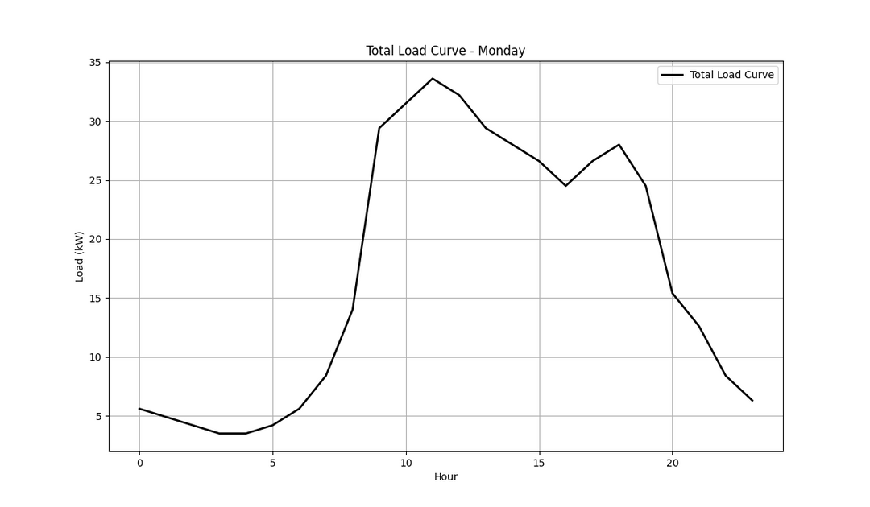
Consume definition
The amount of energy consumed by the actors
Defined as a function of the time of day and distributed among partners.
Calculated as:
actor load = total load per hour / number of actors
where the actor load follow a Dirichlet distribution.

Slide 8


Trading Strategy
Goals
Optimize energy distribution between producers and consumers, ensuring:
01
02
03
04
Key Components
Cost efficiency
Reliability
Adaptability
Prosumer: Energy providers with variable prices and reliability.
Consumer: Entities purchasing energy to meet their loads.
Load Curve: Energy demand at a given time.
Production Curve: Energy generated for distribution.
Choosing the best value for money.
Prioritize partners with high capacity and stability.
Respond to variations in demand and production.

Slide 9
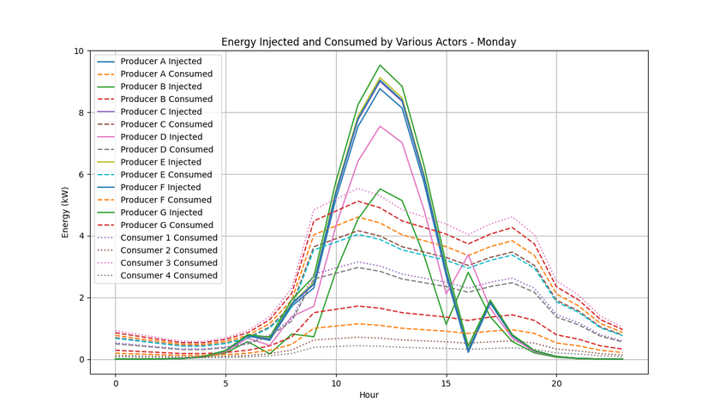
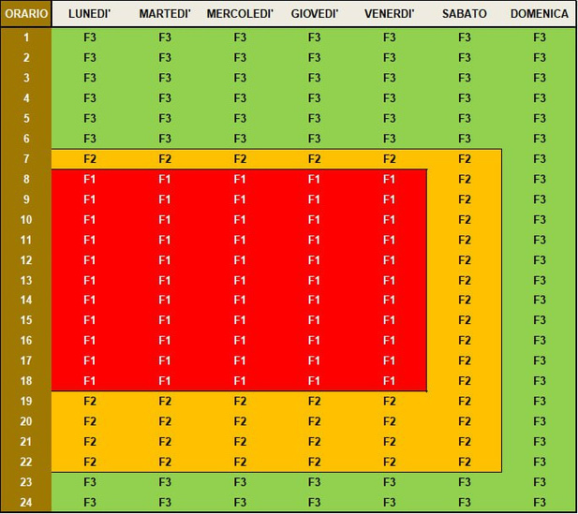
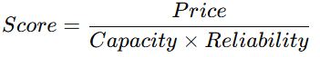
Strategy
Load Curve Distribution
The total load curve is distributed among partners and consumers. The division is made in a random way suing the Dirichlet Distribution. It is, then, Normalized to ensure consistency with the total load.
Best Partner
Selection based on the score and the one with the lowest score is selected
Market Cost and
Price Strategy
It is represented by the price of energy that changes over time. Time is divided into time slots (F1, F2, F3), each representing a price change. The amount of energy available for sale, to_sell, is determined by the difference between production and consumption. If production is high and consumption is low, more energy can be sold at a lower price (partner.price_curve[hour] *= 0.95). Otherwise, if consumption is high and production is low, the price increases by 5% (partner.price_curve[hour] *= 1.05).

Slide 10
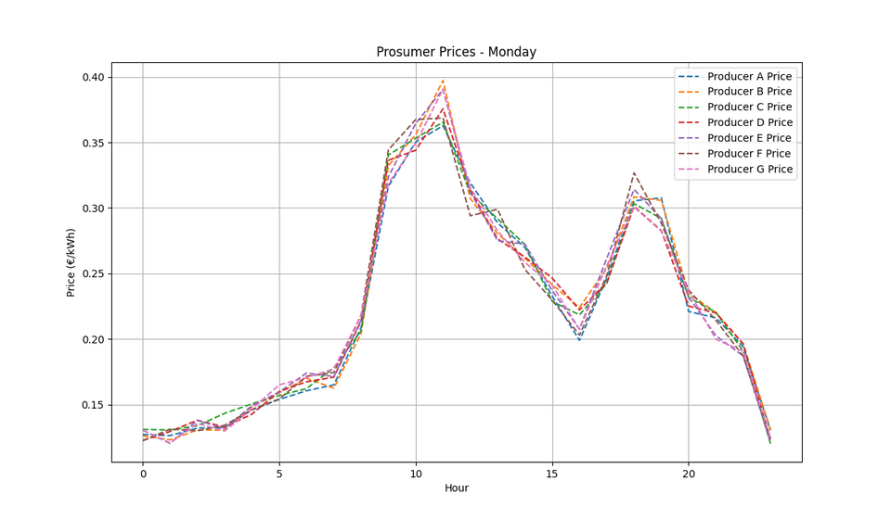
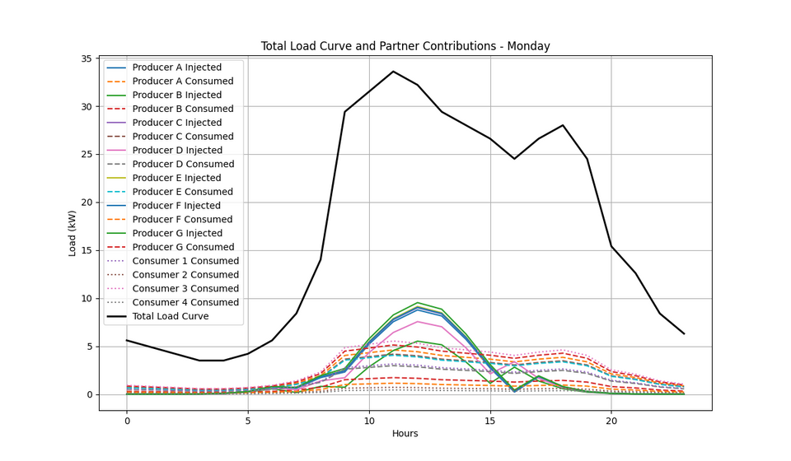
Benefit
Results
Cost Optimization: Competitive prices for consumers.
High Reliability: Partners selected for capacity and stability.
Dynamic Flexibility: Adapts to demand and supply variations.

Slide 11
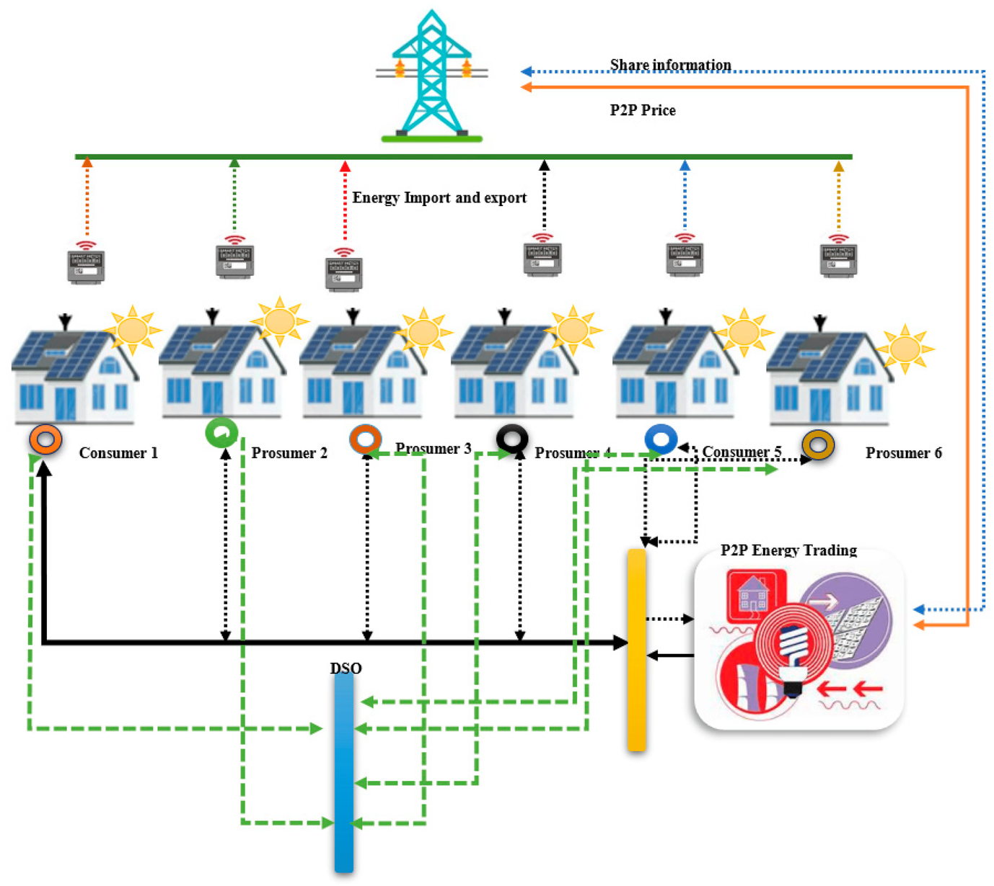
Conclusion
The proposed trading system achieves an effective balance between energy supply and demand, promoting operational sustainability, ensuring transparent pricing, and maximizing profits for energy producers while offering the best price for consumers.

